Slide 1
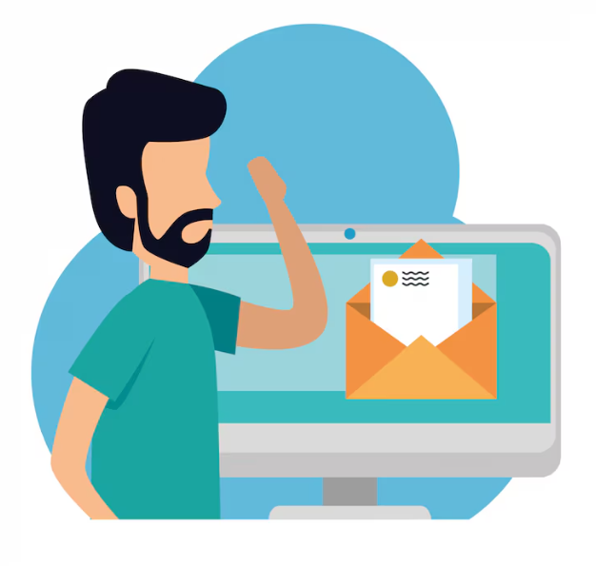
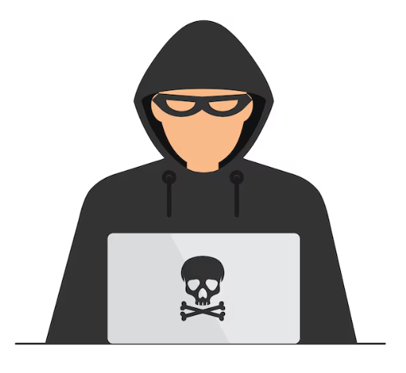
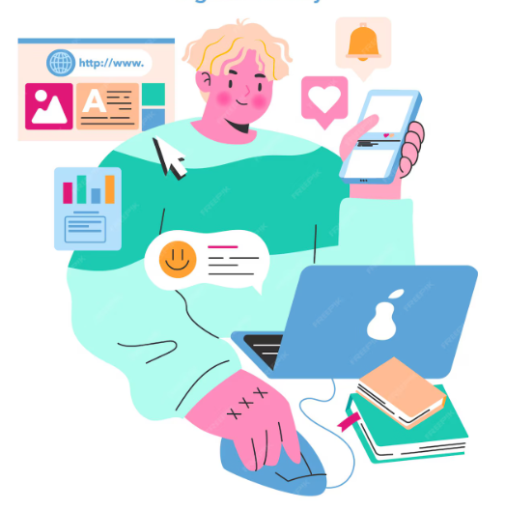
What is Digital Literacy
Digital Literacy Awareness
Email Etiquette
Safe Internet Practices
It’s the ability to find , evaluate , use , and create information using digital technology
Use a clear and relevant subject line
Start with a polite greeting (e.g., Dear Sir/Ma’am/Name)
Keep the message clear and to the point
Avoid slang, emojis, or informal language in formal email
Use strong passwords and enable two-factor authentication
Avoid clicking on suspicious links or emails
Keep your software and apps updated
Do not share personal or financial information online
Critical Thinking: Identify bias and fact check Communication: Collaborate and connect with others Creativity: Produce digital content responsibly
Safety: Understand online risks and protect data
Saket Singh
25BCE11055

